Slide 1
Data Analytics – Techniques for Decision Making Certificate Program
Lesson 6: Probability and Descriptive Statistics

Slide 2
Course Outline
Lesson | Date | Topics
1 | 10/2 | The overall process of making decisions using data
2 | 10/9 | Getting started with data analysis
3 | 10/16 | Data acquisition and preparation
4 | 10/23 | Data Transformation
5 | 10/30 | Grouping and Transforming Data
6 | 11/6 | Probability and Descriptive Statistics
7 | 11/13 | Hypothesis Testing
8 | 11/20 | Introduction to machine learning and data mining
9 | 11/27 | Unsupervised learning
10 | 12/4 | Final Project
Today

Slide 3
Agenda
1.5.1 Introduction to statistics, including: operationalization of concepts (concept to number conversion), qualitative vs. quantitative data.
1.5.2 Mean, Mode, Median, Variance, Standard Deviation
1.5.3 Probability
1.5.4 Normal Distribution (Bell-curve)
1.5.5 Confidence Intervals, Z-Score
1.5.6 Correlation and Causation
1.5.7 Excel Statistical Functions and Charts (last use of XL in course)
1.5 Lab Assignment: Descriptive Statistics review using a housing dataset.

Slide 4
Math is Fun!
Jenny bought 2 toys (A and B) for $1.10.
Toy B was $1 more expensive than toy A.
How much is the toy A?

Slide 5
Math is Fun!
In a lake, there is a patch of lily pads. Every day, the patch doubles in size. If it takes 48 days for the patch to cover the entire lake.
How long would it take for the patch to cover half of the lake?

Slide 6
1.5.1 Introduction to statistics

Slide 7
Definitions
Statistics - branch of mathematics, methods of data collection and interpretation
Inferential Statistics - infer population characteristics based on a sample
Descriptive Statistics - describe the data

Slide 8
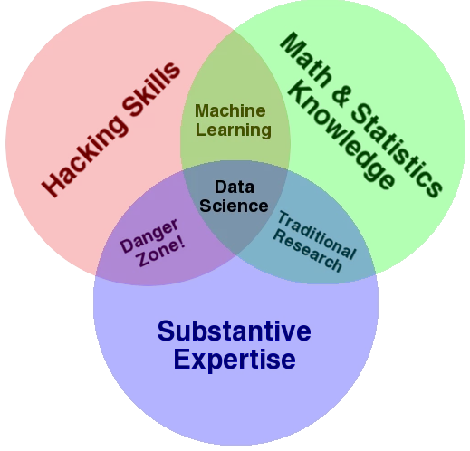
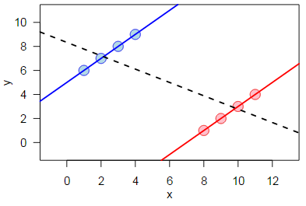
Data Science Perspective
Simpson’s paradox
Drew Conway’v venn: https://s3.amazonaws.com/aws.drewconway.com/viz/venn_diagram/data_science.html
Simpson’s paradox: http://en.wikipedia.org/wiki/Simpson%27s_paradox

Slide 9
Variable Types
Quantitative
Qualitative
Numeric
Some values are higher than others
+/- meaningful
↑↓ meaningful
Observations closer in value are closer in nature (Age, Height)
Categorical / Nominal
Values are just labels
+/- isn’t [typically] meaningful
Could have ordering (S, M, L)
OR not: Apples, Oranges; Yes, No
“This restaurant is the best”
Likable (EQ), Smart (IQ) … but needs recoding
Continuous | X
Discrete | X | X

Slide 10
1.5.2 Mean, Mode, Median, Variance, Standard Deviation

Slide 11
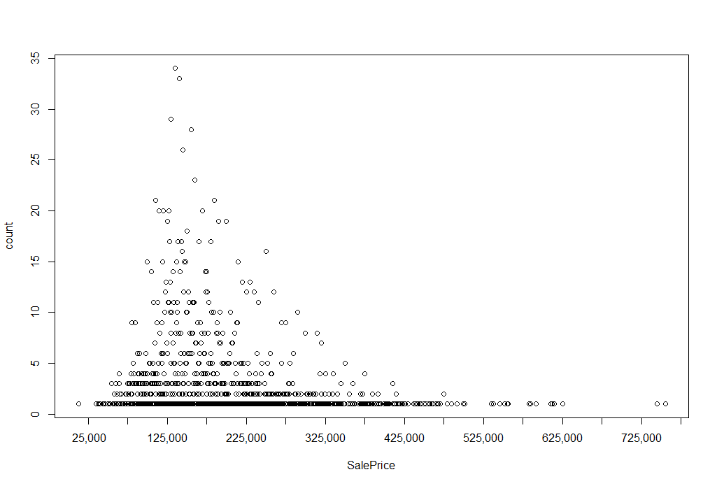
Frequency Distribution
grouped_pricing <- AmesHousing %>%
group_by(SalePrice) %>%
summarise(count=n())
plot(grouped_pricing)
axis(side=1, at=histinfo$mids,
labels=format(histinfo$mids, format="d", big.mark=','))

Slide 12
Histogram Information
histinfo <- hist(Housing$SalePrice, plot = FALSE)
print(histinfo)
Outputs:
$breaks - beginning and end points of each bar $counts - count of items in each bucket $density - probability that a random variable falls within each bar $mids - midpoints of each bar

Slide 13
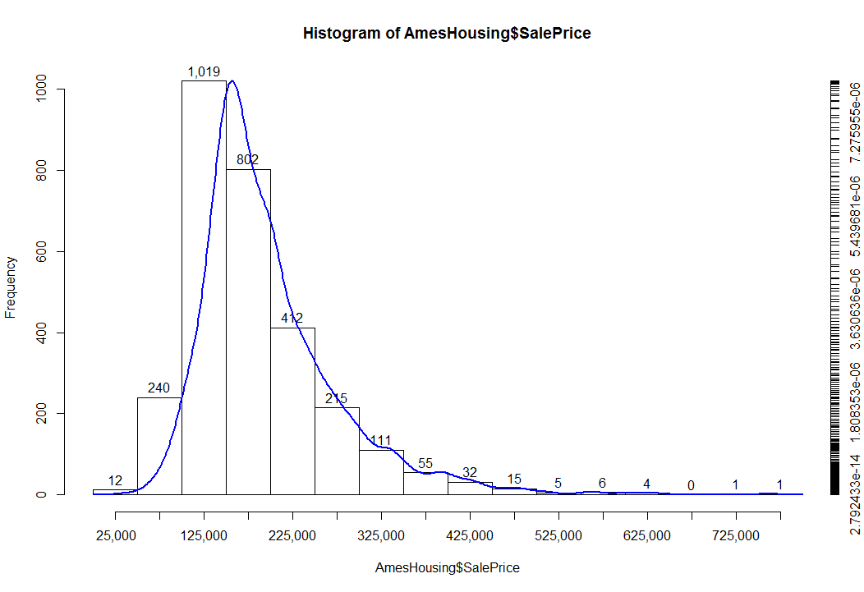
Histogram
hist(Housing$SalePrice, …)
plot(density(Housing$SalePrice)$y, …)

Slide 14
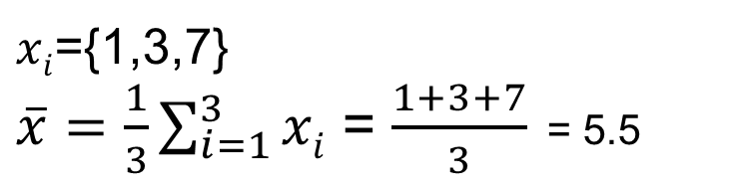
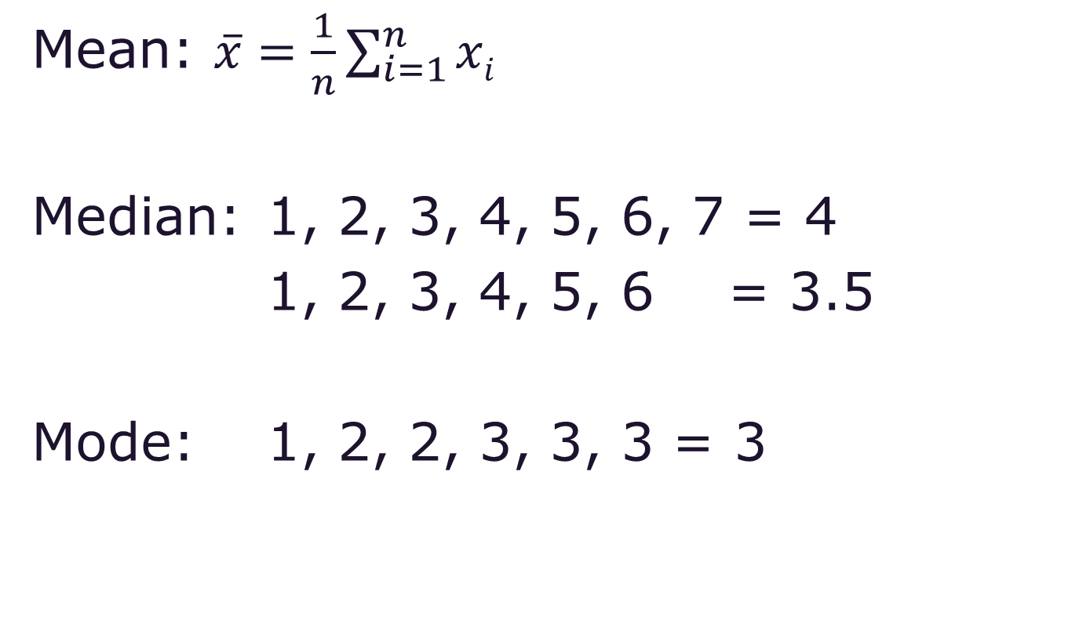
Statistics – Descriptive Central Tendency

Slide 15
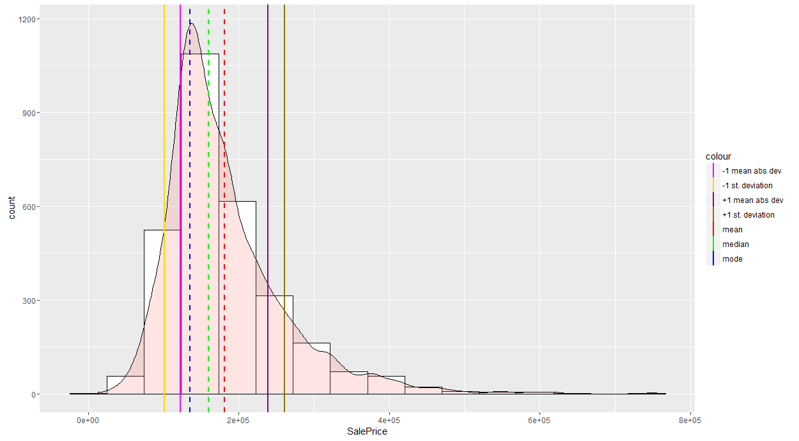
Histogram With Distribution Characteristics
mode = $135,000
median = $160,000
mean = $180,796.06

Slide 16
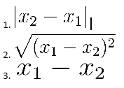
Data Mining is [Almost] All About Distance
What is the distance D between X1 and X2?
X₁
X₂
Hints: distance should [almost] always be positive

Slide 17
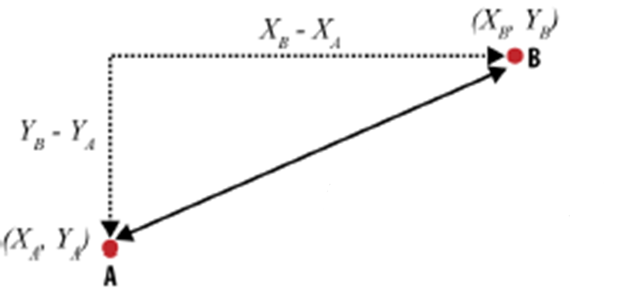
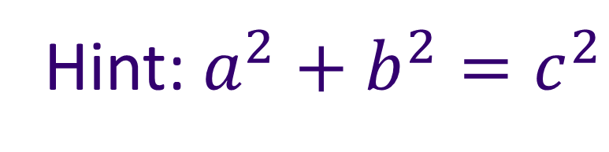
How About in 2D?
Hint: $a^{2}+b^{2}=c^{2}$

Slide 18

Distance in 2D
|AB| = $\sqrt{{\left(X_{B}− X_{A}\right)}^{2}+{\left(Y_{B}− Y_{A}\right)}^{2}}$

Slide 19
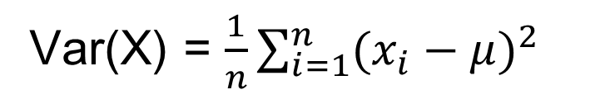
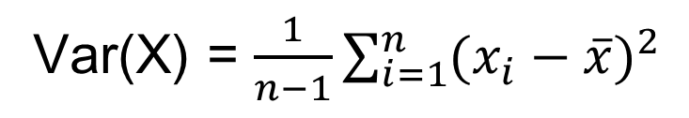
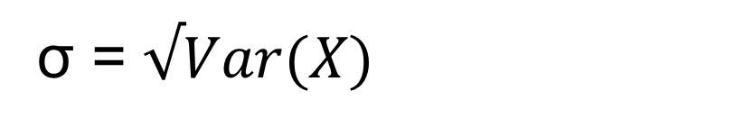
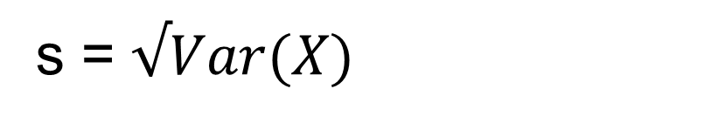
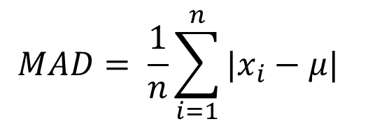
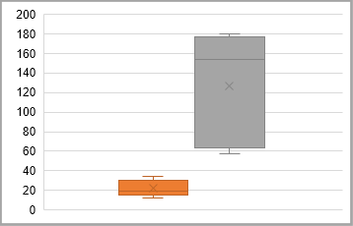
Other Distance Metrics
Population
Sample
Variance
Standard Dev.
Example
Plant | Span | Height
1 | 18.1 | 69.93
2 | 19.77 | 153.58
3 | 34.15 | 179.48
4 | 12.56 | 57.25
5 | 27.59 | 174.26
Median | 19.77 | 153.58
Mean | 22.434 | 126.9
Variance | 57.45 | 2,763.23
StDev | 7.58 | 52.57
MeanAD | 6.75 | 50.65
Height
Span

Slide 20
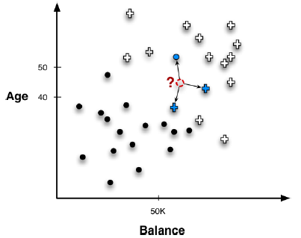
Other Distance Metrics: KNN
What class o or + the observation ? belongs to?

Slide 21
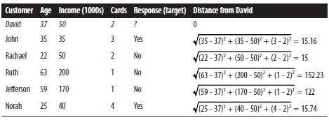
KNN Classifier Exercise

Slide 22
1.5.3 Probability

Slide 23
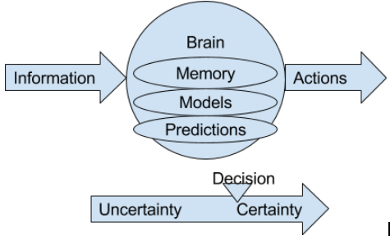

Probability P(E)
Probability is the measure of the likelihood that an event will occur on a scale from 0 to 1.

Slide 24
Probability P(E)
Key take out: many gotchas
High-level overview today
In depth: UW Math 394 - 396, 521 – 523, 590
Key Formulas ... simple stuff:
S = {heads, tails}
0≤P(E) ≤ 1; P(heads) = 0.5;
P(S) = 1; Ex: P(heads + tails)=1
P(F) + P(~F) = 1; Ex: P(heads) + P(~heads)=1

Slide 25
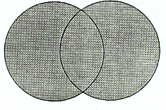
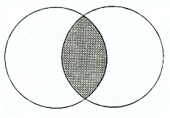
Probability P(E)
Key Formulas:
Mutually exclusive E&F (OR):
P(E U F) = P(E) + P(F)
Ex: P(En)=0.2, P(Fr)=0.1 => P(En U Fr) = 0.2+0.1=0.3
Independent E&F (AND):
P(E ∩ F) = P(E) * P(F)
Ex: P(En ∩ Fr) = 0.2*0.1=0.05
Not mutually exclusive E&F:
P(E U F) = P(E) + P(F) - P(E ∩ F)
Ex: P(En ∩ Fr)=0.05, => P(En U Fr) = 0.2+0.1-0.05=.25

Slide 26
Exercise: Probability P(E)
In 2014 Seattle had 40,434 property crimes per 640,500 people (~6%).
If you live in Seattle what is your lifetime probability of property crime?
Assumptions: 1. 80 year lifespan;
2. crime rate is constant over life;
3. events are independent: P(E ∩ F) = P(E) * P(F)
Hint: P(~theft) = 1-P(theft)
https://data.seattle.gov

Slide 27
Exercise: Probability P(E)
In 2014 Seattle had 40,434 property crimes per 640,500 people.
If you live in Seattle what is your lifetime probability of property crime?
Assumptions: 1. 80 year lifespan;
2. crime rate is constant over life;
3. events are independent: P(E ∩ F) = P(E) * P(F)
Hint: P(~crime) = 1-P(crime)
Annual probability: 40434/640500 ≈ 0.06 = 6%
P(~theft, over 80 years) = (1-0.06)^80 ≈ 0.007
P(theft, over 80 years) = 1 – 0.007 ≈ 99%

Slide 28

Probability P(E)
Intersection of dependent events
P(E ∩ F) = P(E) * P(F | E)
Exercise:
You are on a game show.
3 doors 2 goats 1 car.
You selected a goat. Door with the goat will remain open. What is the probability of picking 2nd goat given your first selection?
Tip: your second selection depends on your first

Slide 29
Probability P(E)
Intersection of dependent events
P(E ∩ F) = P(E) * P(F | E)
Door 1 | Door 2 | Door 3 | Stay | Switch
Car | Goat | Goat | Car | Goat
Goat | Car | Goat | Goat | Car
Goat | Goat | Car | Goat | Car
1/3 | 1/3 | 1/3
1/3 | 2/3 | 0 – opened

Slide 30
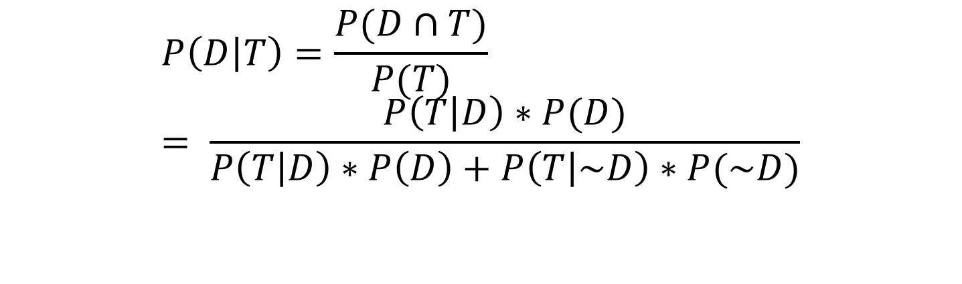
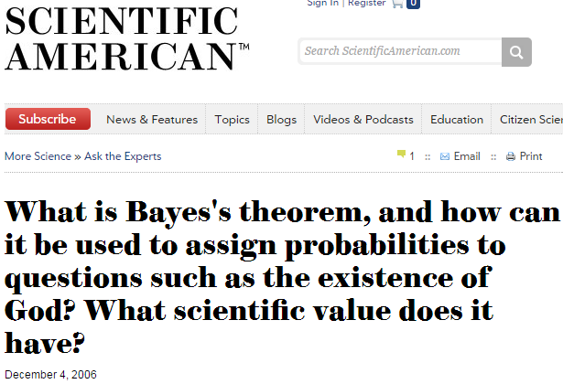
Bayes Theorem
“[It] is so general that almost every application of probability or statistics must invoke Bayes's theorem at some point.
In that sense Bayes's theorem is at the heart of everything from genetics to Google, from health insurance to hedge funds. It is a central relationship for thinking concretely about uncertainty, and … for using mathematics as a tool for thinking clearly about the world.”

Slide 31
1.5.4 Normal Distribution (Bell-curve), Central Limit Theorem

Slide 32
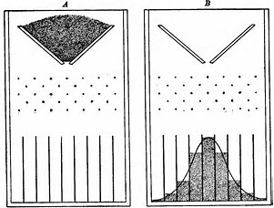
https://youtu.be/3m4bxse2JEQ
https://youtu.be/6YDHBFVIvIs
Galton Board

Slide 33
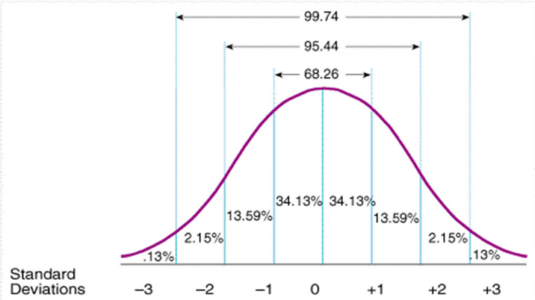
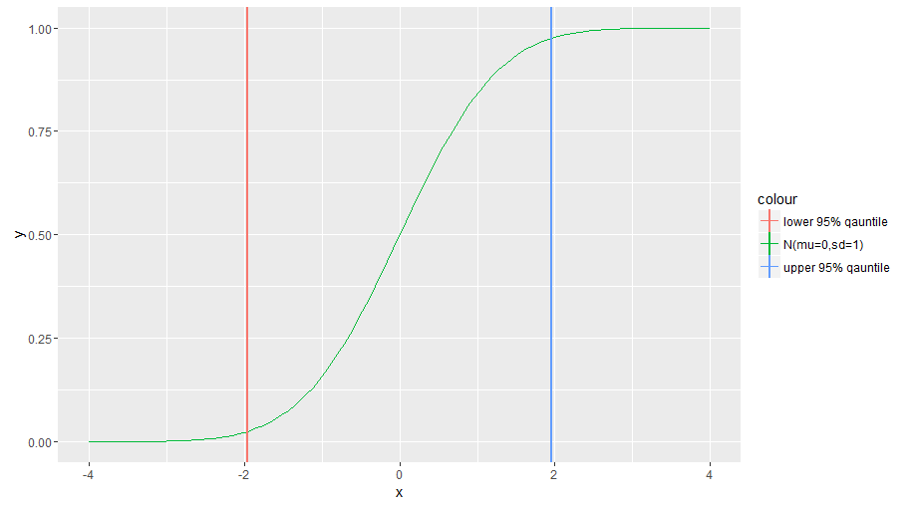
Standard Normal Distribution
68% of values falls within 1 standard deviation of the mean
95% within ≈ 2 standard deviations
99% within ≈ 3 standard deviations
Symmetrical
Continuous - ∞ + ∞
Total area under the curve = 1
Median = Mean = Mode = 0
Density Plot
Cumulative Probability Plot

Slide 34
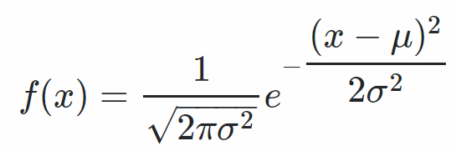
Normal Distribution
All characteristics of the normal distribution
Mean <> 0
General formula:

Slide 35
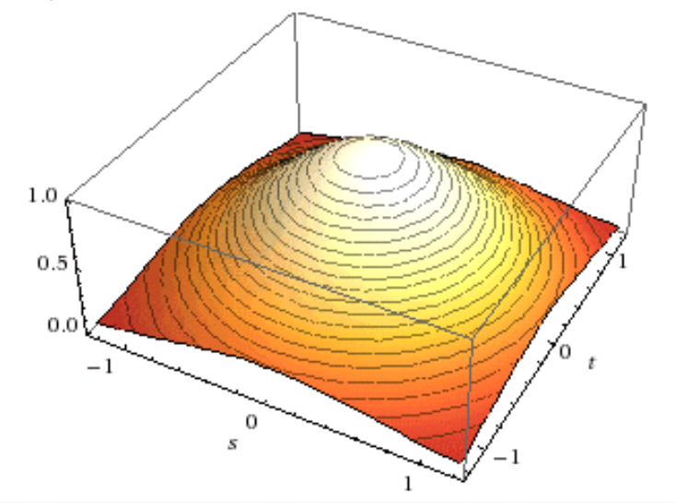
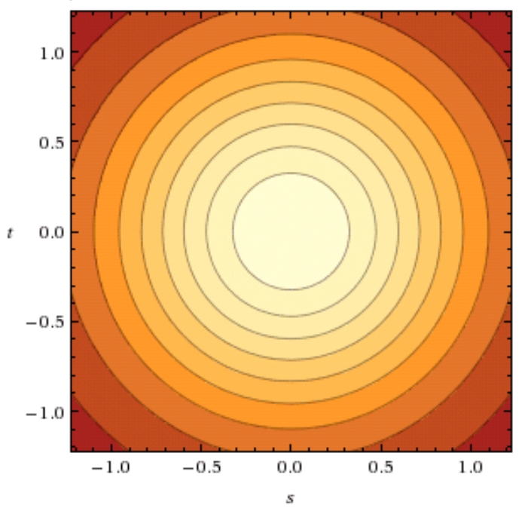
Multidimensional Visual

Slide 36
1.5.5 Confidence Intervals, Z-Score

Slide 37
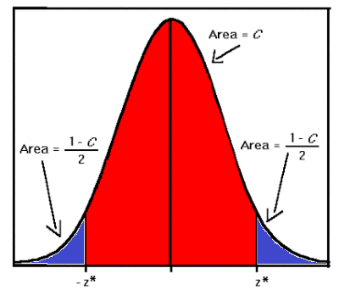
Confidence Level | Z* value
95% | 1.96
98% | 2.33
99% | 2.58
Confidence Interval
Has 2 parts:
An interval for estimate x
[-margin of error, +margin of error]
or x±margin of error
Confidence level C (an area under the curve), a probability that interval has the estimated value
Z* - critical value of standard normal distribution

Slide 38
Confidence Intervals
Confidence interval - range with true (actual) value of an estimated population parameter in future repeated samples
= estimate +/- margin of error
Expressed as [a,b] or a - b, where a, b - confidence limits
Accompanied by confidence level - probability of the confidence interval to contain value of an estimated population parameter in future repeated samples/experiments
Narrow interval - more precise estimate

Slide 39

Z-score
Z-score (a.k.a standard score) - signed distance between variable and the mean for population
μ - mean of the population
σ - standard deviation of the population
R function: scale() - important in your toolkit to normalize features.

Slide 40
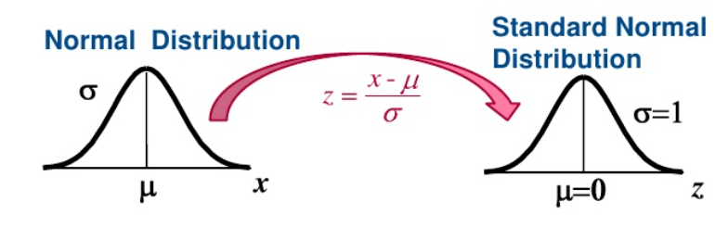
The Standard Normal Distribution

Slide 41
1.5.6 Correlation and Causation

Slide 42
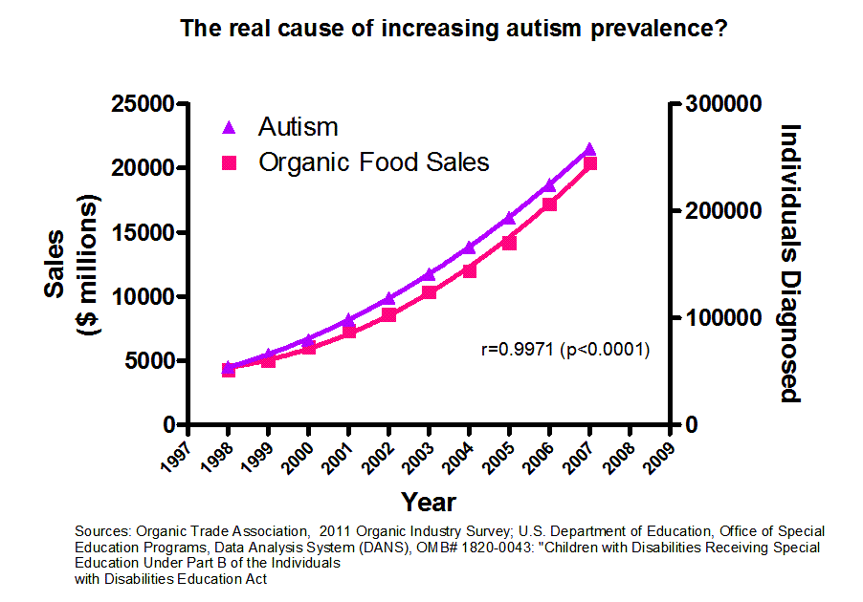
Correlation and Causation

Slide 43
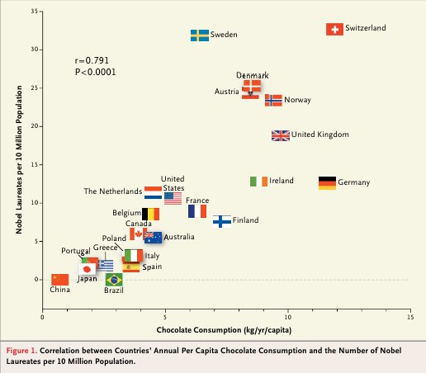
Correlation and Causation

Slide 44
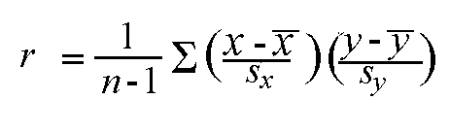
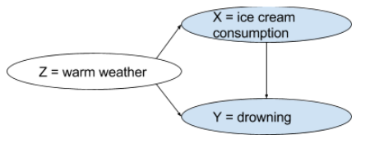
Correlation and Causation
Correlation – an extent of linear relationship Expressed by correlation coefficient r:
r ∈ [-1, 1]
0 – no relationship
-1 or 1 – perfect correlation
Causation - extent of understand what variables influence response, correlation doesn’t imply causation
Confounder - a variable that affects both dependent and independent variables
x and y are the sample means of X and Y, and s_{x} and s_{y} are the corrected sample standard deviations of X and Y

Slide 45
Avoiding Correlation is Causation Conclusions
More details in the next class.
How to design statistical experiments?
Fix all the variables, except the one evaluated
Exercise: what can we fix on the autism diagram?
You customer has a drop in web sales
Exercise: one reason from each student
Exercise: which reasons could be confounded

Slide 46
1.5.7 Excel Statistical Functions and Charts (last use of XL in course)

Slide 47
Excel Statistical Functions
AVERAGE(...) - average of arguments
CORREL(array1, array2) correlation coefficient between two data sets
COUNT(...) counts numbers in the list of arguments
COUNTA(...) counts non-empty cells
COUNTIF(range, criteria) counts cells within a range that meet criteria
FORECAST.LINEAR(points_to_predict, known_y, known_x) returns a value along a linear trend
LINEST() parameters of a linear trend
MAX(...) maximum value in a list of arguments
MEDIAN(...) median of the given numbers
MIN(...) minimum value in a list of arguments
STDEVA(...) estimate of standard deviation based on a sample, works on numbers, text, and logical values
Z.TEST(...) one-tailed probability-value of a z-test

Slide 48
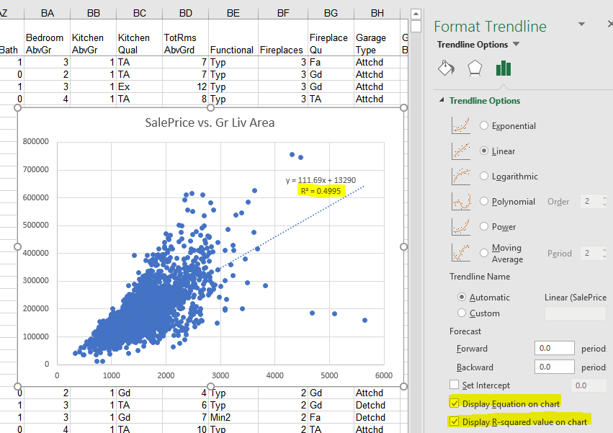
Excel Statistical Charts

Slide 49
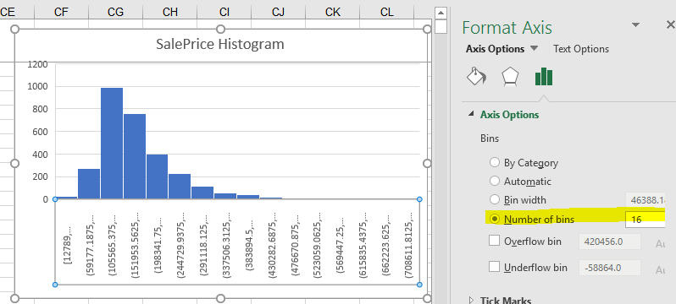
Excel Statistical Charts

Slide 50
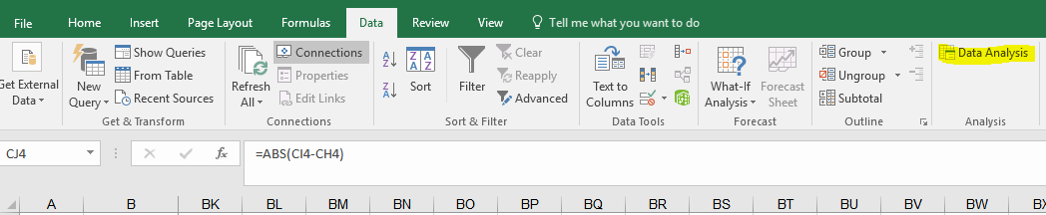
Excel Statistical Tool Pack: Analysis Tool Pack
Anova
Correlation
Covariance
Descriptive Statistics
Exponential Smoothing
F-Test Two-Sample for Variances
Fourier Analysis
Histogram
Moving Average
Random Number Generation
Rank and Percentile
Regression
Sampling
t-Test
z-Test

Slide 51
End Of Lesson 5

